Slide 1
Fundamentals of Electric Grid Transmission Plannning
Talk 9: Generation Interconnection Studies
Tracy Rolstad
Tracy.Rolstad@trinasolar.com

Slide 2
Review the relevant FERC orders, OATT’s, LGIP’s
Vertically integrated utility generation interconnects are IRP driven
They still need to generally follow the SGIP/LGIP processes
Merchant generators
SGIP/LGIP/OATT
Does everyone know what these are?
Pro forma OATT with appendices and OASIS will spell out how this is done
Studies
Transmission service requests
Feasibility study
System impact study
Facility study
Transmission service requests

Slide 3
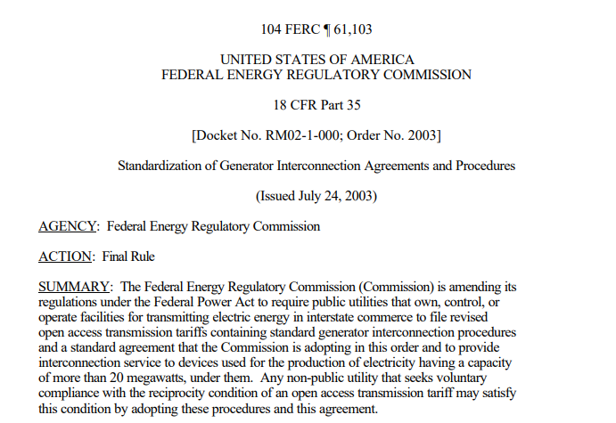
FERC Order 2003
Read it!
Standardization of Generator Interconnection Agreements and Procedures (ferc.gov)
420 pages of fun reading…

Slide 4
FERC Definition of Feasibility Study (Order 2003)
The Interconnection Feasibility Study shall preliminarily evaluate the feasibility of the proposed interconnection to the Transmission System. The Interconnection Feasibility Study will consider the Base Case as well as all Generating Facilities (and with respect to (iii), any identified Network Upgrades) that, on the date the Interconnection Feasibility Study is commenced: (i) are directly interconnected to the Transmission System; (ii) are interconnected to Affected Systems and may have an impact on the Interconnection Request; (iii) have a pending higher queued Interconnection Request to interconnect to the Transmission System; and (iv) have no Queue Position but have executed an LGIA or requested that an unexecuted LGIA be filed with FERC. The Interconnection Feasibility Study will consist of a power flow and short circuit analysis. The Interconnection Feasibility Study will provide a list of facilities and a non-binding good faith estimate of cost responsibility and a non-binding good faith estimated time to construct.

Slide 5
Failure is not an option
Even if the interconnection request is ridiculous, aka throwing spaghetti at the wall to see if it sticks, you MUST determine what it takes to make a project feasible.
One hopes that a smart developer will take the hint and accept the culling of their project.
A smart Transmission Provider will preemptively study injection capabilities and post that data…wait, queue FERC Order 2023 and heatmaps
PWS ATC tool, Nira, Velocity Suite, PowerGem TARA, PTI MUST, etc

Slide 6
NRIS versus ERIS
There are FERC definitions, but…
Network Resource Interconnection Service request looks like firm service to the host utility’s designated network resource stack.
OASIS is where you will find the list of designated network resources
Energy Resource Interconnection Service looks like maybe non-firm service to “the system.” This partly emulates a market based off-taker. A interconnection Super Area sink (excluding the host utility) is a way to model the sink.
ERIS might be cheaper, but don’t count on it.
Always ask for both studies. The cost difference is hardly notable. You SHOULD see some difference in results although they might be subtle.
There is much debate about where to sink proposed generation sources…

Slide 7
Transmission Service (OASIS)
Network Integration Transmission Service (NITS)
A deliverable network resource has the transmission service to meet its load obligations. This transmission service is called Network Integration Transmission Service (NITS). Interconnection customers who use this service are called network customers. An external resource, i.e., non “designated network resource,” needs this NITS reservation to serve network load.
Point-to-Point (PTP) Transmission Service
A transmission service reservation that only works for a designated transmission path with its source and the sink, i.e., where the reservation ends. This Point-to-Point comes in two primary flavors – firm and non-firm. Non-firm transmission reservations are cut first, before firm reservation under emergency conditions. In both firm and non-firm, transmission customers can procure daily, weekly, and monthly. Generally only hourly non-firm and yearly firm transmission service is offered.

Slide 8
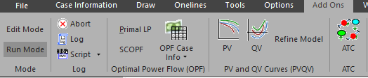
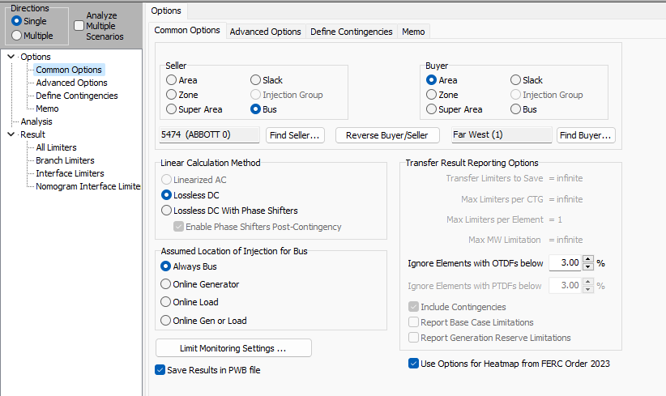
Use of the ATC Tool
Open the ACTIVSg2000 case
Go to add-ons
Run mode, ATC
Dialog setup as shown
Analyze, see results next page

Slide 9
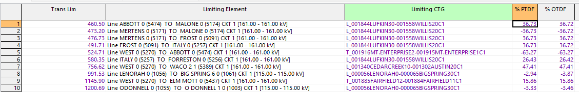
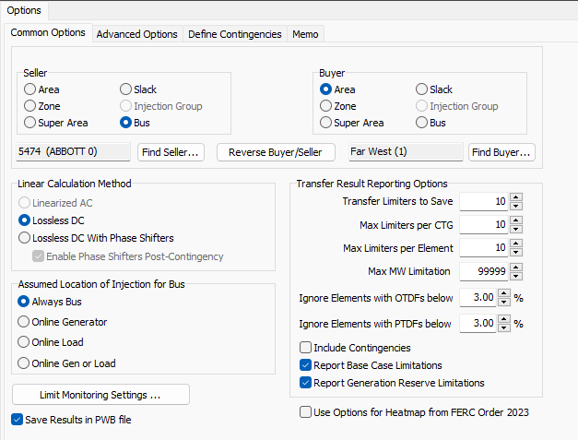
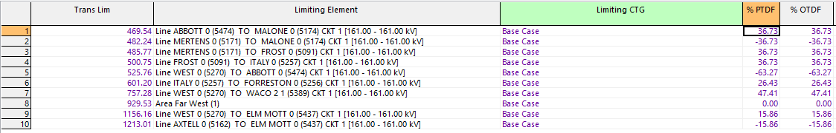
ATC Heat Map Results plus ALIS (One POI)
“Heat Map” results…Tom can speak in detail to this tool
More manual approach, base case 10/10/10

Slide 10
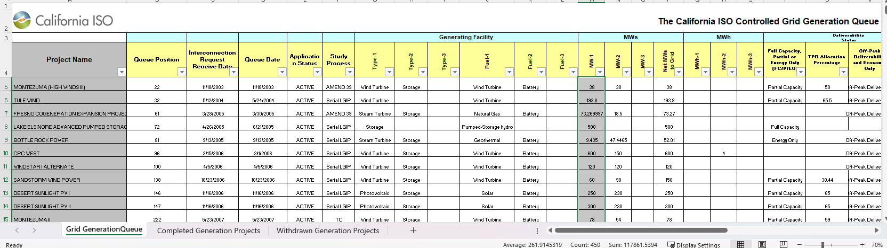
ATC tool leads us to appropriate ctgs’ (if not all)
You WILL do this for FERC Order 2023
Or something like it
You should do this with an Ops case (no queue) and the full up queued case
Why?
See below sum of 117,861 MW. The 29HS WECC case dispatched is ~204 GW gen

Slide 11
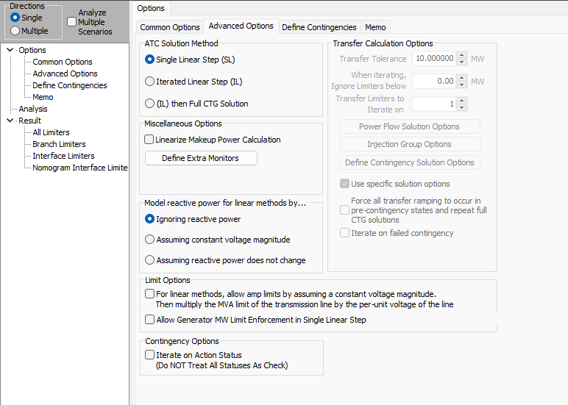
Tools within the ATC tool
ATC Solution Method
Improved accuracy
Slower
Or…Distributed Computing!
Multiple Directions

Slide 12
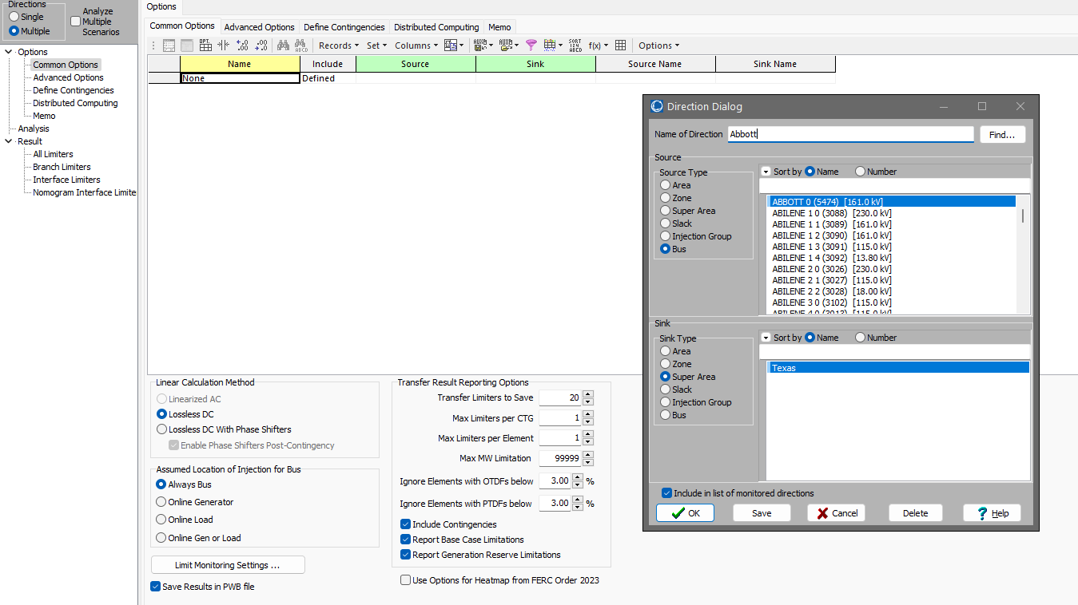
How a developer might use the ATC tool
Some Excel work
Get syntax
Get bus table
Concatenate/paste
=CONCATENATE("BUS ","'",A3,"'")

Slide 13
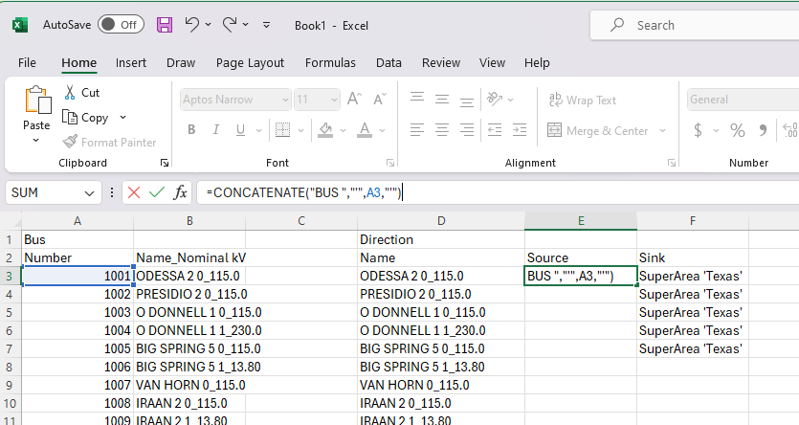
Excel work for Multiple ATC
Paste into ATC

Slide 14
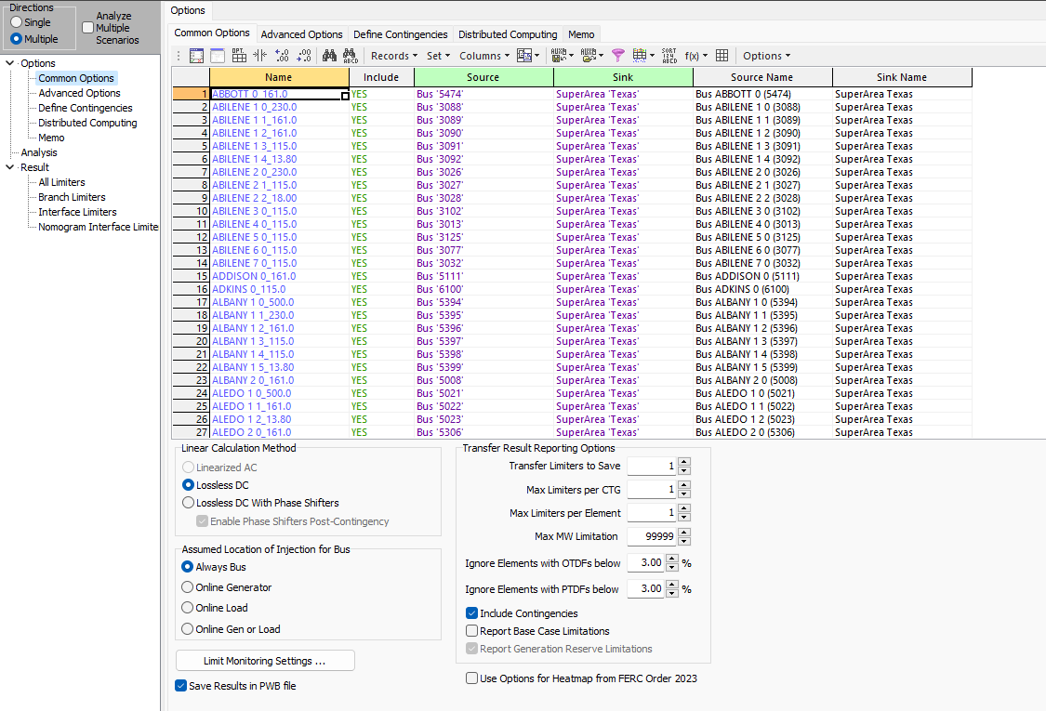
Add auto-insert N-1, use distributed computing

Slide 15
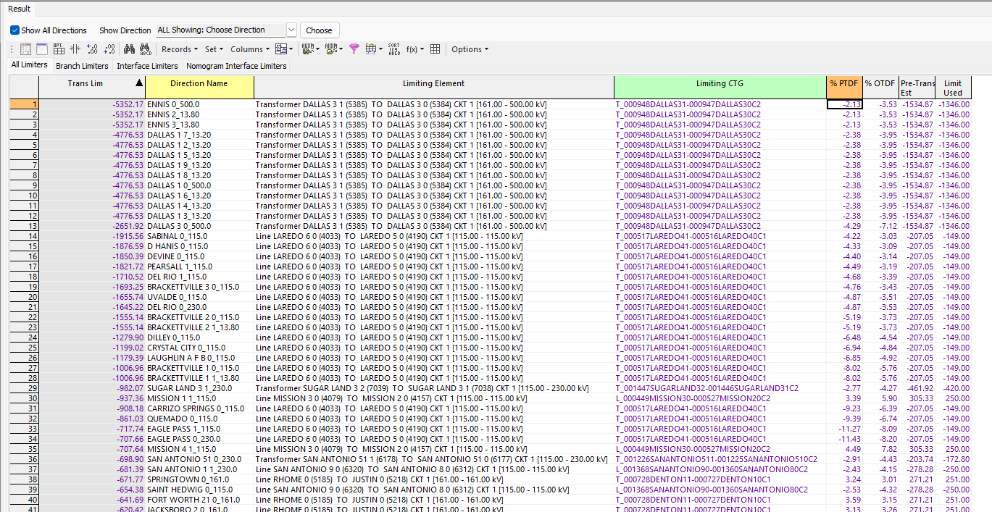
Negative numbers not so favorable

Slide 16
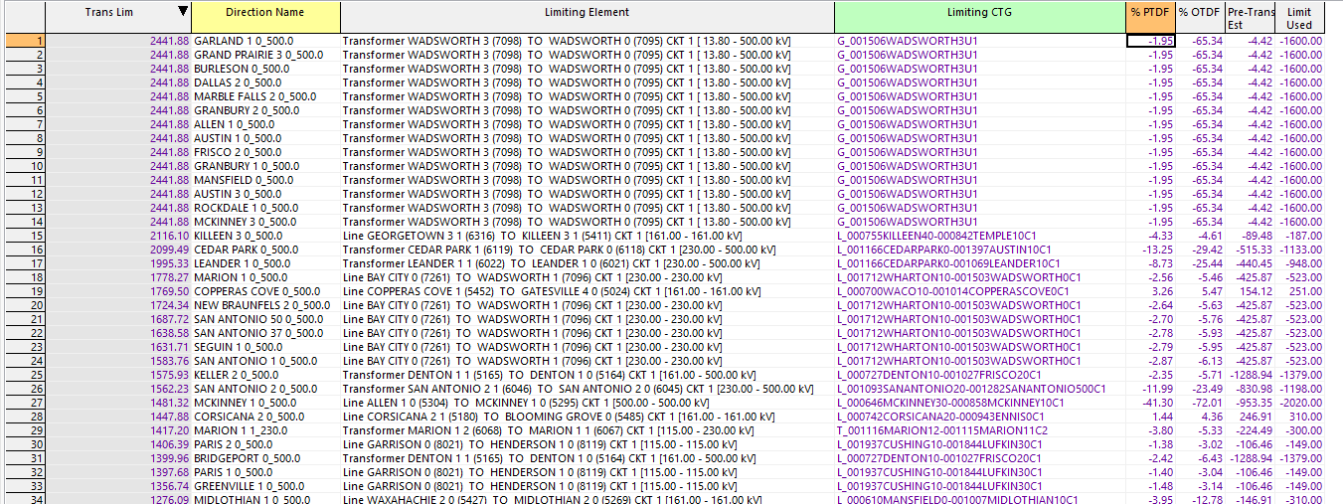
Positive are better

Slide 17
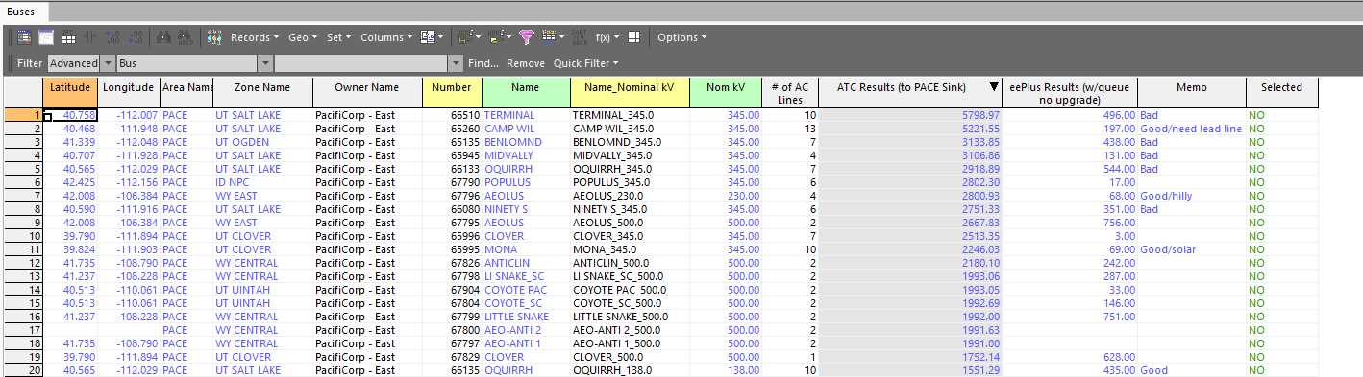
A clever method is to past back in ATC results
Do the ATC work first
Paste back in PWS
Look at network buses (>2 branches) and voltages
Filter, right click to bus dialog, go look at imagery

Slide 18
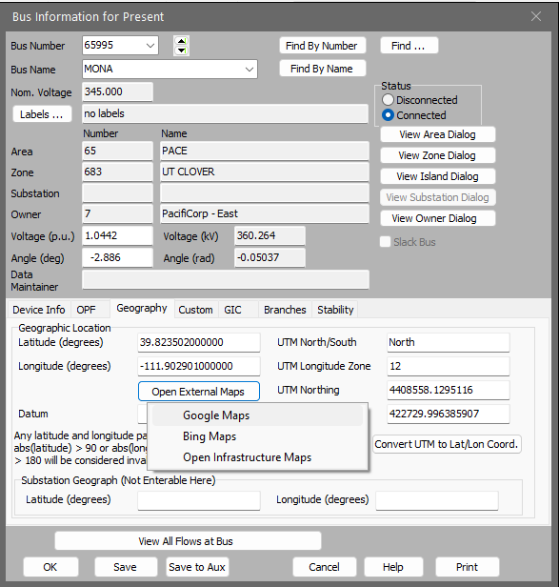
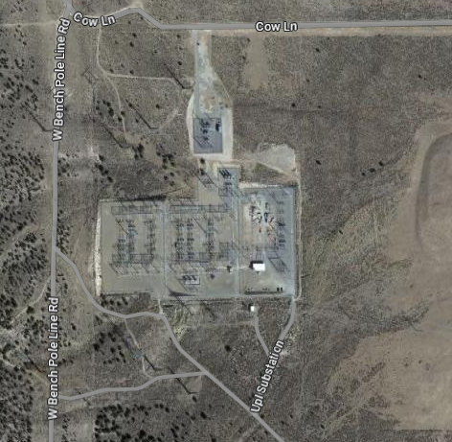
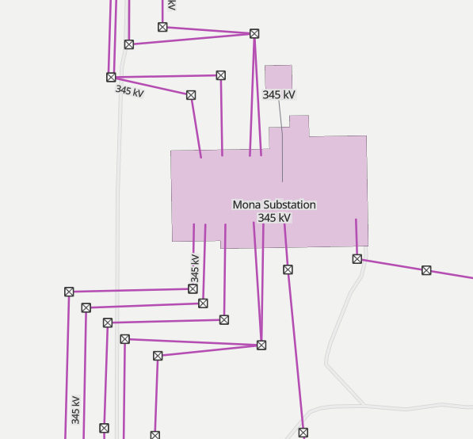
What a developer should be doing…
Two imagery sources
And the excellent Open Infrastructure

Slide 19
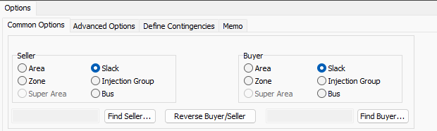
Next steps after ATC (still a feasibility study)
Everyone should use the ATC tool
Do check charging as well as discharging for batteries
Reverse Buyer/Seller
Next, traditional power flow work
Ctgs, RAS, different seasons, queue impacts
This is what a utility MUST do, but developers should do modest work themselves
Voltage stability IS power flow work
Do PV & QV work for charging (& discharging)
Charging is generally the place where a PV curve noses over first

Slide 20
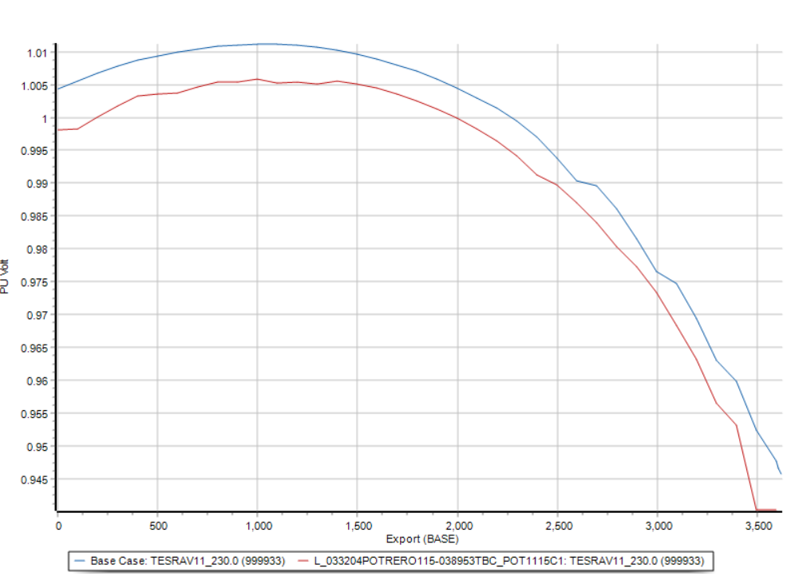
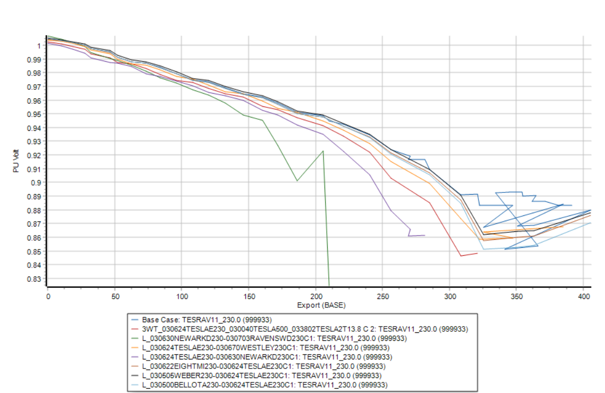
Example charge vs. discharge PV curve

Slide 21
Short Circuit Analysis (still feasibility)
PWS gives a solid first screen answer
ASPEN, CAPE, etc dedicated SC tools should be used…by Protection folks
Whole point here is to see if new projects get close to fault duty limit
Screen at 90% fault duty, 5% modeling error, 5% margin
See NextEra Seabrook GSU breaker replacement and Good Utility Practice
FERC ruled against them…

Slide 22
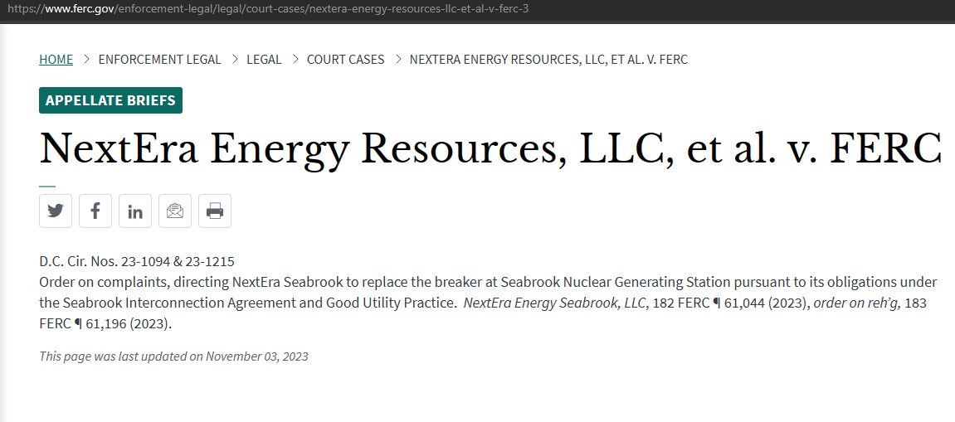
Good Utility Practice still exists!
NextEra Energy Resources, LLC, et al. v. FERC | Federal Energy Regulatory Commission

Slide 23
The System Impact Study (FERC)
The Interconnection System Impact Study will consist of a short circuit analysis, a stability analysis, and a power flow analysis. The Interconnection System Impact Study will state the assumptions upon which it is based; state the results of the analyses; and provide the requirements or potential impediments to providing the requested interconnection service, including a preliminary indication of the cost and length of time that would be necessary to correct any problems identified in those analyses and implement the interconnection. The Interconnection System Impact Study will provide a list of facilities that are required as a result of the Interconnection Request and a nonbinding good faith estimate of cost responsibility and a non-binding good faith estimated time to construct.

Slide 24
Building off the Feasibility Study (SIS)
The Feasibility Study provides the bulk of the input work for the System Impact Study (report that is) for:
Power flow
Short circuit
Stability is the challenging part
Demand that the generation technology be almost completely decided upon
This means equipment supplier of generation and, likely, inverters!
Insist on EMTP data and stability data BEFORE you purchase equipment
If you do it after you pay for the generators, inverters, etc then good luck getting modeling help from the supplier
Insist on models being part of the purchase, it will be “free” when embedded in a multi-million-dollar project

Slide 25
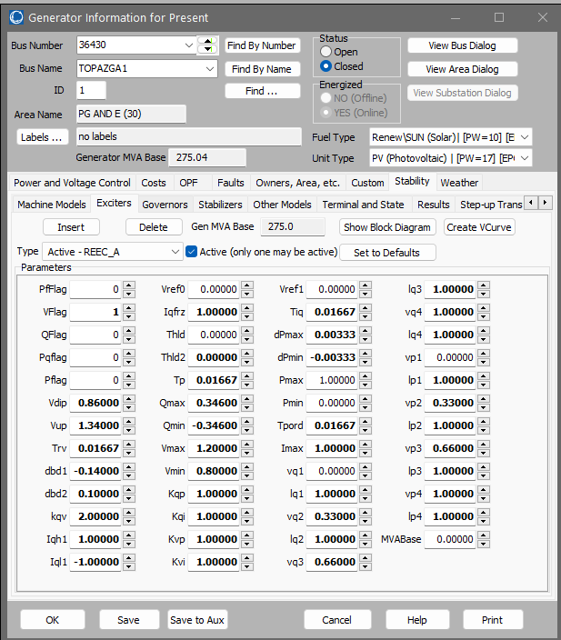
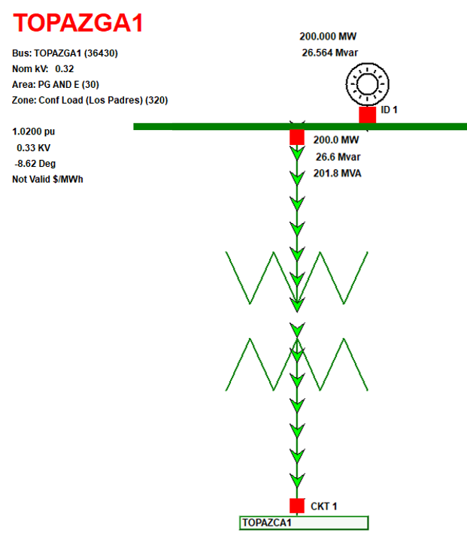
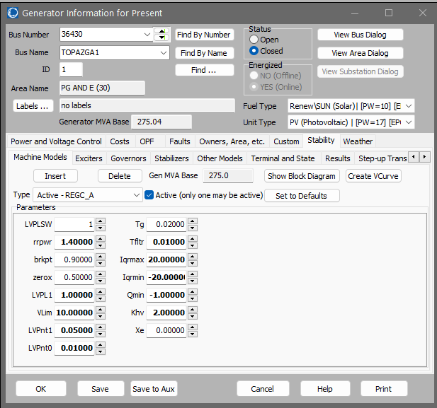
Your goal is something like this
Topaz…550 MW photovoltaic

Slide 26
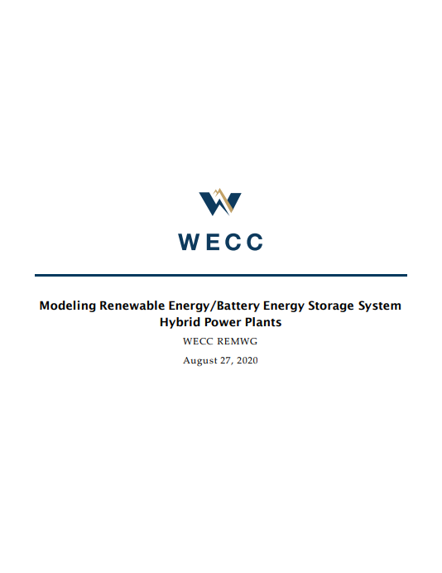

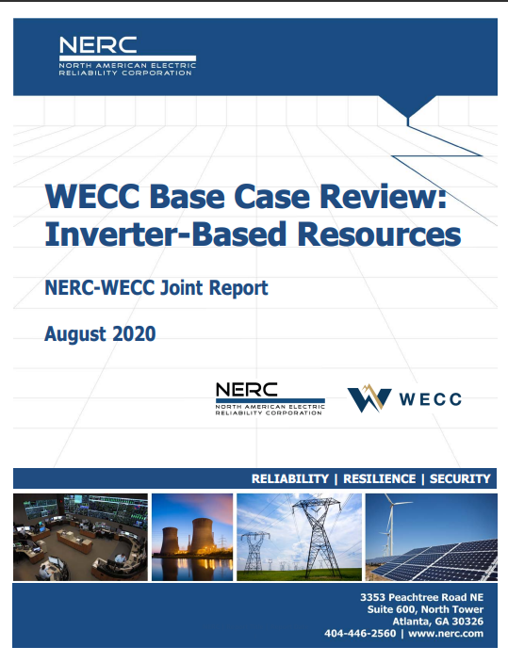
Presume renewable gen…WECC is here to help
www.wecc.org & www.nerc.org
Google the titles…DEMAND your supplier provides quality models (in detail)

Slide 27
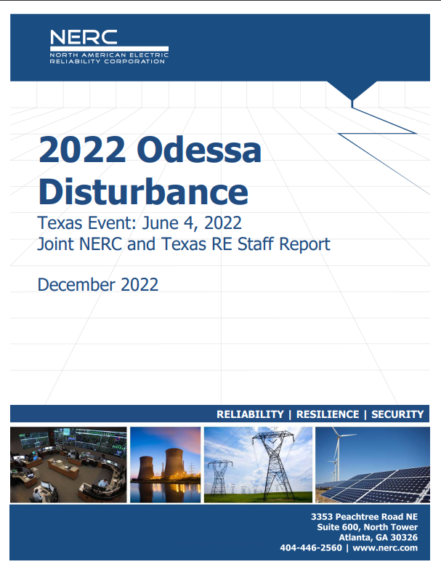
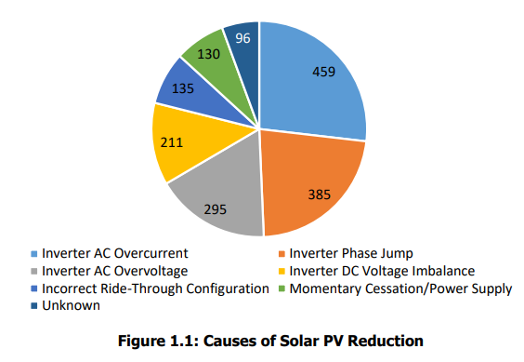
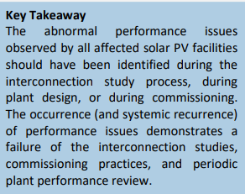
Or…you too can star in a report…
Physical features were not modeled
DEMAND the model from the supplier
Know the equipment

Slide 28

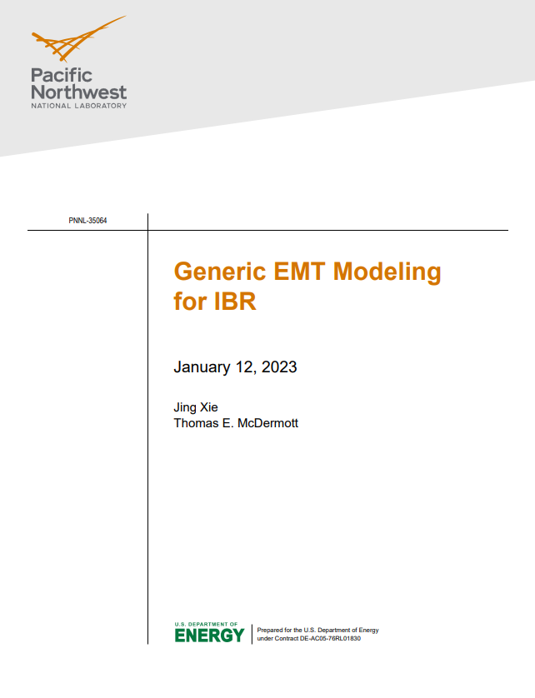
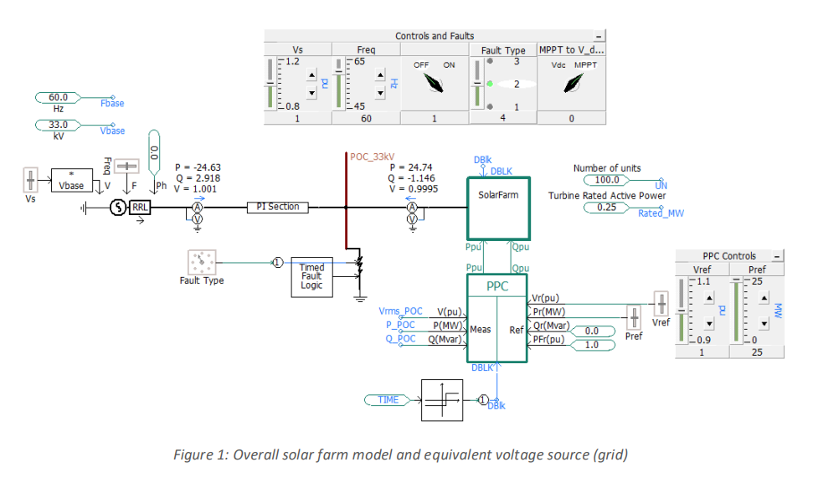
Don’t forget EMTP Models (System Impact Study)
PSCAD, ATP, ETAP, etc

Slide 29
Facility Study (no traditional study work, but…)
The Interconnection Facilities Study shall specify and estimate the cost of the equipment, engineering, procurement and construction work needed to implement the conclusions of the Interconnection System Impact Study in accordance with Good Utility Practice to physically and electrically connect the Interconnection Facility to the Transmission System. The Interconnection Facilities Study shall also identify the electrical switching configuration of the connection equipment, including, without limitation: the transformer, switchgear, meters, and other station equipment; the nature and estimated cost of any Transmission Provider's Interconnection Facilities and Network Upgrades necessary to accomplish the interconnection; and an estimate of the time required to complete the construction and installation of such facilities.

Slide 30
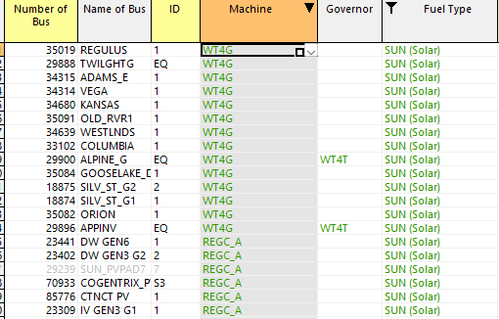
Build a Planning Library of Renewable Data
Strip mine existing cases for examples
Some examples are what NOT to do…
There are 550 REGC_A examples
These are better…
Don’t use wind models for solar, really
Oh…don’t have solar on for a Light case…aka 0400
Reliability Assessment Committee MVS (wecc.org)
Also, short circuit contribution from IBR’s are limited by power electronics
Short circuit contribution is typical 1.1 to 1.5 per unit generator current
Nothing at all like a collapsing emf…traditional protection methods are being challenged
Sound Planning includes Protection, so learn more about it

Slide 31
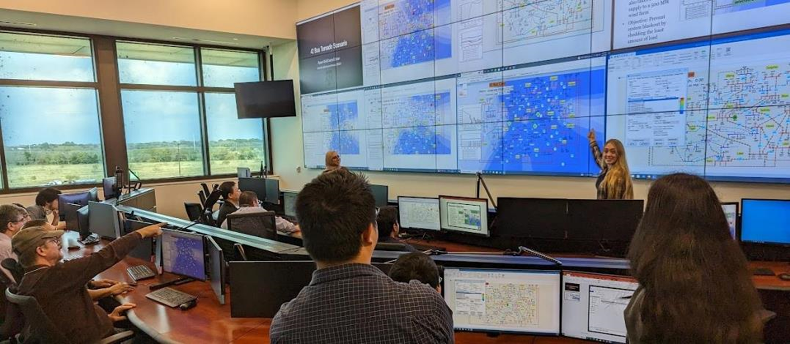
Questions?
30

